Slide 1


SWARNA BHARTHI INSTITUTE OF SCIENCE & TECHNOLOGY
DEPARTMENT OF ELECTRONICS & COMMUNICATION ENGINEERING
A MAJOR PROJECT STAGE-I
ON
“WIRELESS SYSTEM FOR TRAFFIC SIGN IDENTIFICATION AND VIOLATION MONITORING”
UNDER THE GUIDANCE OF:
MS.P.NAGA LAXMI, M.TECH
ASSISTANT PROFESSOR
Presented by: IV-ECE
N.MANIKUMAR(18M61A04A7)
HEAD OF THE DEPARTMENT:
Dr.K. AMIT BINDAJ M. Tech, Ph. D, MIEEE
PROFESSOR

Slide 2
CONTENTS
ABSTRACT
INTRODUCTION
BLOCK DIAGRAM
HARDWARE REQUIREMENT
SOFTWARE PROTOCOL
ADVANTAGES
APPLICATIONS
CONCLUSION
REFERENCES

Slide 3
ABSTRACT
In the field of Vehicular automation, the detection of traffic signs plays a vital role. Enormous growth has been faced in the field.
Violating the traffic sign rules might lead to accidents where the life of people would be at stake.
Hence, to avoid these problems this project has proposed a prototype in such a way that, it detects the traffic signs and acts accordingly denying the user’s control in real-time if he tries to violate the rules in the traffic sign.
The prototype contains a traffic system, which is controlled with an 8051 Microcontroller.

Slide 4
INTRODUCTION:
Travel is an important part of today’s fast-paced life as everyone has to move around for their day-to-day life.
Road transport is the most commonly used mode of travel due to its ease, low cost, and availability to the common man.
Increase in population and traffic has resulted in traffic jams and traffic rules violations.
An accident survey estimated that around 3,00,000 accidents occur on Indian roads every year.
Violation of signals results in a number of accidents. The major problem is the manual tracking of every single vehicle that violates signals.
This problem can be brought under control if the tracking can be automated along with calculating and updating the fines.
In the existing systems, the tracking of signal violations is implemented using image processing techniques.

Slide 5
PROPOSED TECHNOLOGY
RFID based violation systems use radiofrequency waves to identify the vehicles that are endowed with unique identification numbers in the form of RFID tags.
RFID is one of the upcoming technologies in the field of engineering and innovation. It has a number of applications in the market starting from vehicle identification at tolls to security systems at malls.
The RFID based system consists of 3 main components, namely
FFID Reader.
RFID Tags.
RFID database.

Slide 6
BLOCK DIAGRAM OF THE PROJECT
switch
8
0
5
1
16X2 LCD
Traffic light
RFID
Modem
Max-232
GSM
Tag

Slide 7
HARDWARE COMPONENTS
8051 MICROCONTROLLER
RFID Reader
RFID Tag
LCD
GSM
TRAFFIC LIGHT.

Slide 8
SOFTWARE PROTOCOL:
PROTEUS
Proteus is a simulation and design software tool developed by Lab center Electronics for Electrical and Electronic circuit design.
It is a software suite containing schematic, simulation as well as PCB designing.
ISIS is the software used to draw schematics and simulate the circuits in real-time. The simulation allows human access during run time, thus providing real-time simulation.
It deserves to bear the tagline “From concept to completion”.
KEIL
The Keil 8051 Development Tools are designed to solve the complex problems facing embedded software developers.
When starting a new project, simply select the microcontroller you use from the Device Database and the µVision IDE sets all compiler, assembler, linker, and memory options for you.

Slide 9
SWITCH:
A switch is a device in a computer network that connects other devices together.
Multiple data cables are plugged into a switch to enable communication between different networked devices.

Slide 10
RFID READER:
The RFID reader is a network-connected device that can be portable or permanently attached.
It uses radio waves to transmit signals that activate the tag.
RFID TAG:
Radio Frequency identification uses electromagnetic fields to automatically identify and track tags attached to the objects.
An RFID consists of a tiny radio transponder, a radio receiver, and a transmitter.
LCD:
LCD stands for liquid crystal display.
A liquid crystal display is a flat-panel display or other electronically modulated optical device that uses the light modulating properties of liquid crystals in combination with polarizers.
Liquid crystals do not emit light directly, instead of using a backlight or reflector to produce images in color or monochrome.

Slide 11
TRAFFIC LIGHT:
Traffic lights, traffic signals or stoplights are signaling devices positioned at road intersections, pedestrian crossings, and other locations to control flows of traffic.
The Reasons TRAFFIC LIGHTS are RED, YELLOW, GREEN
RED:
Red is an inherited symbol from railroads.
GREEN:
Green means caution at first.
YELLOW:
YELLOW means caution because it’s almost as easy to see as red or green.

Slide 12
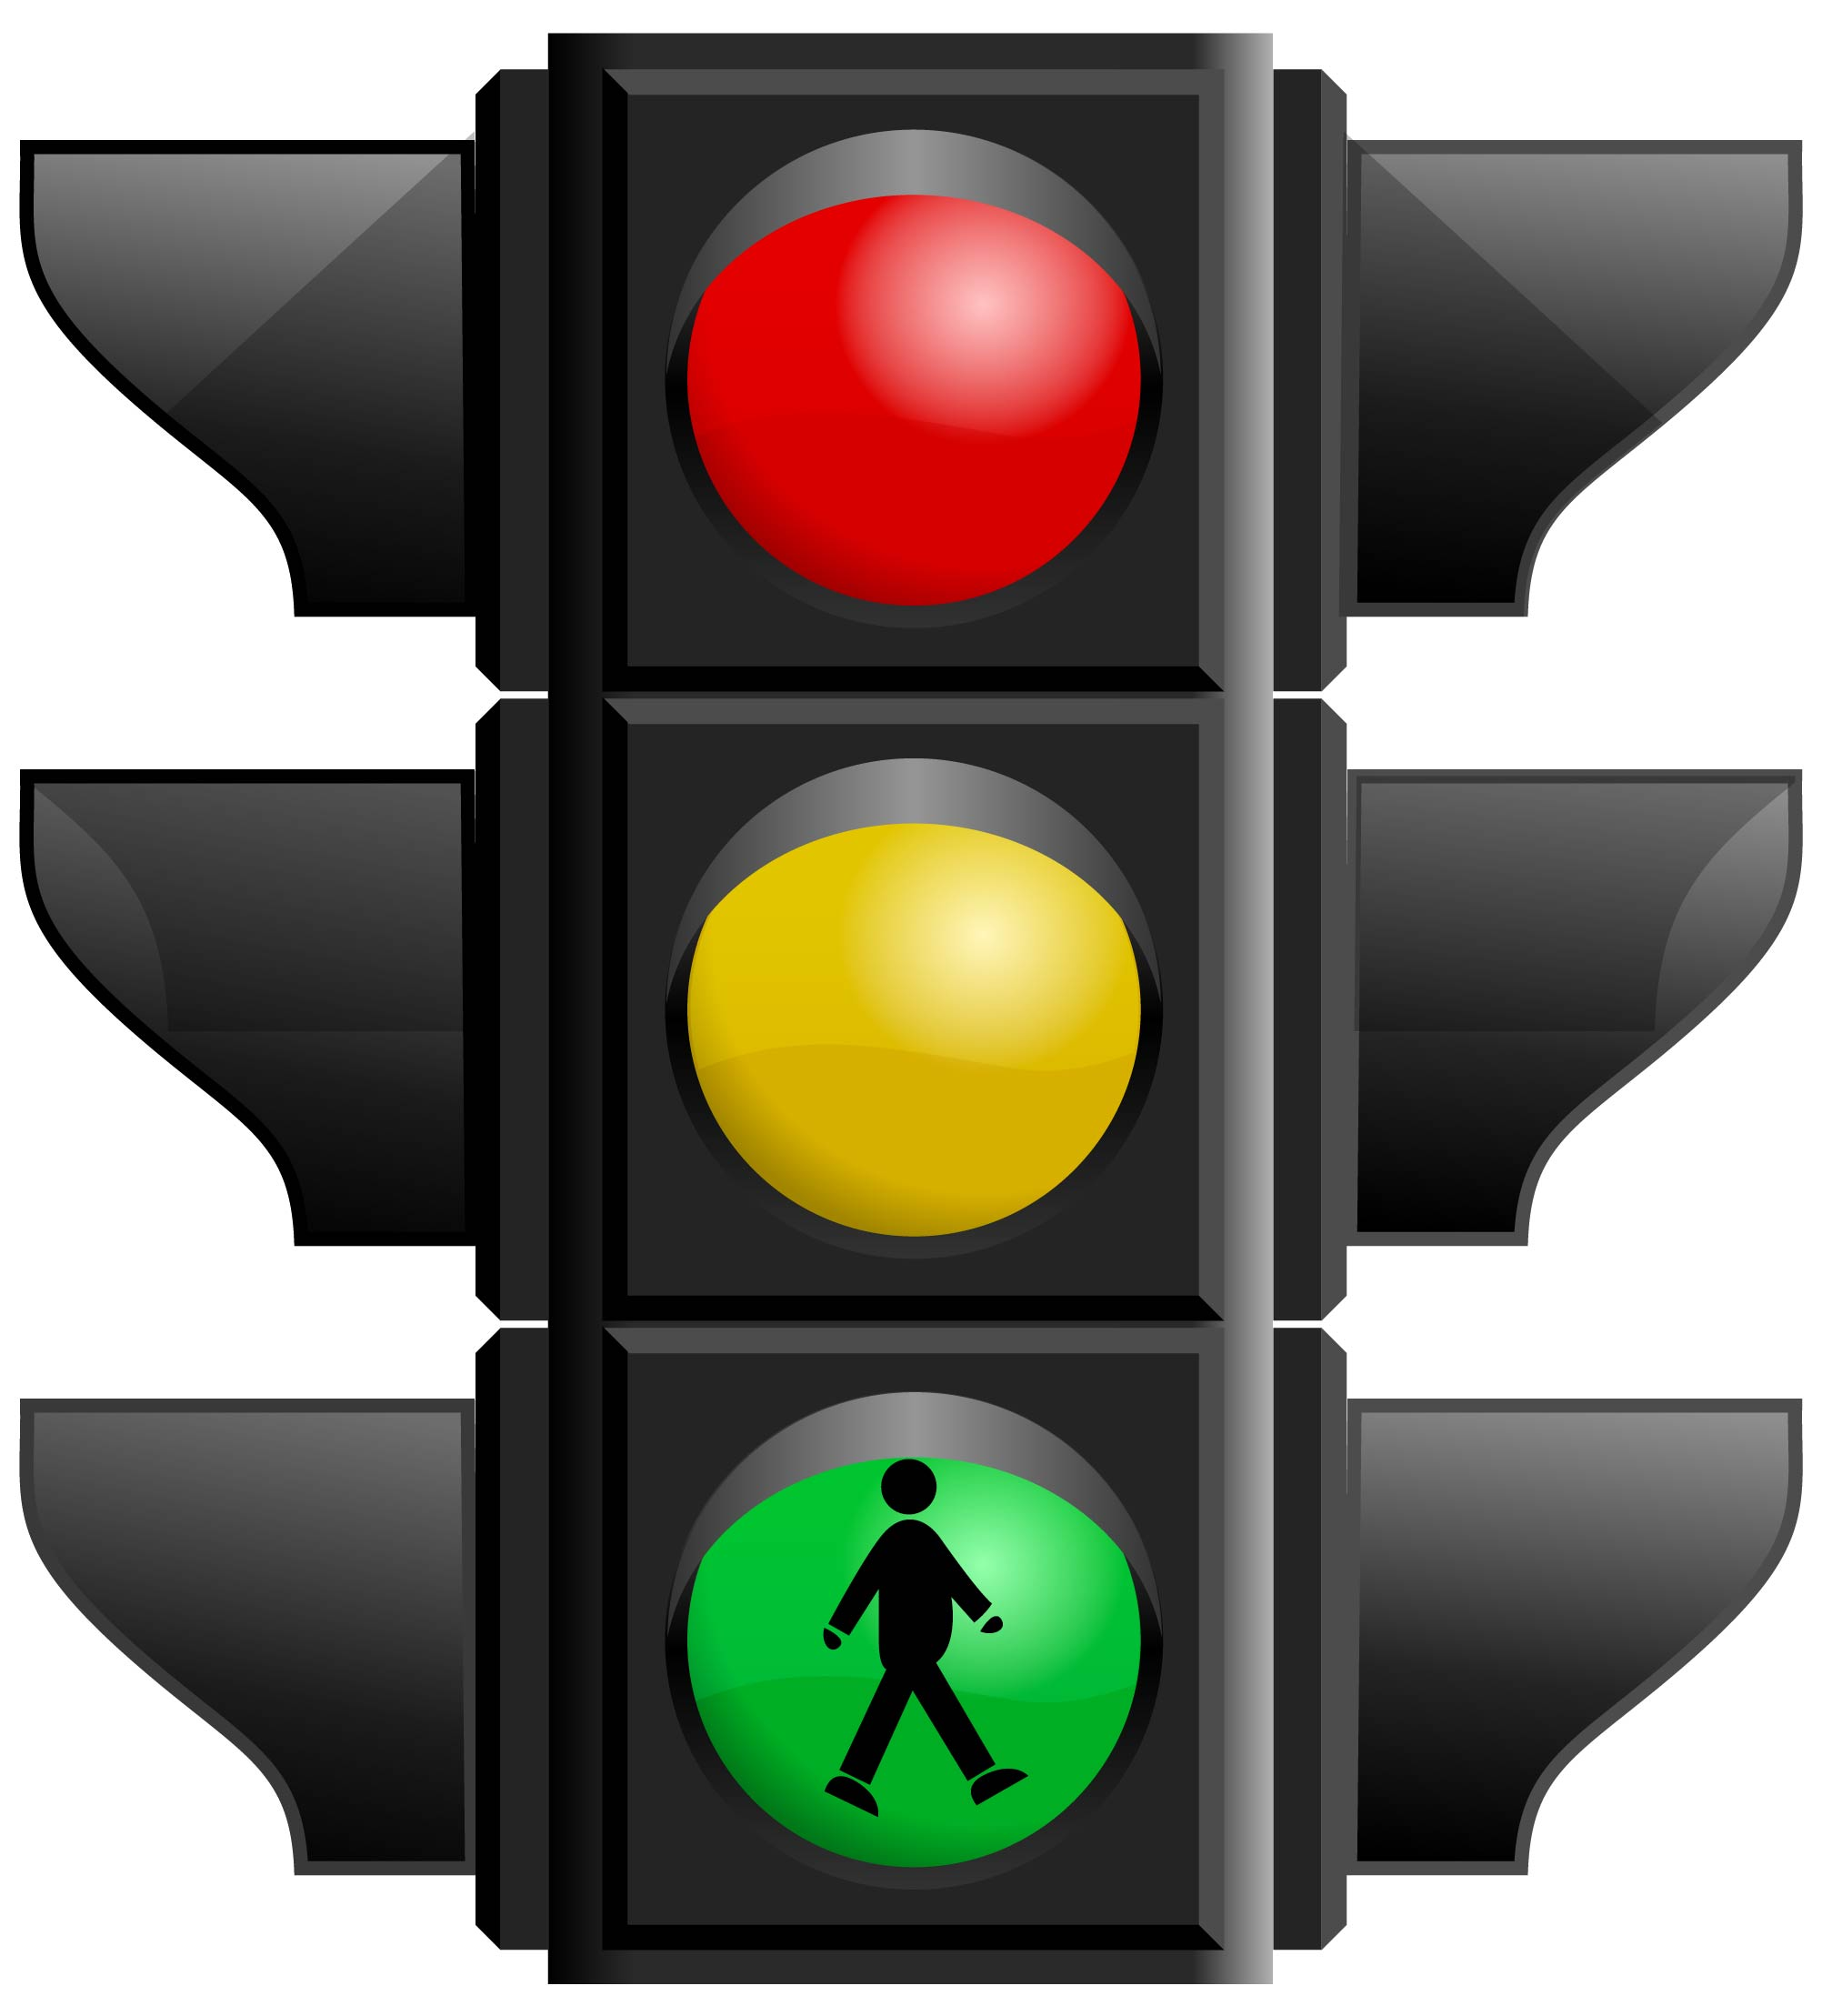
TRAFFIC LIGHTS are RED, YELLOW, GREEN

Slide 13
GSM:
It is used for data security and data transmission.
The GSM technology is used which uses mobile stations, base stations, and network systems.
The mobile station consists of the basic mobile access point or the mobile phone and links the mobile phones with the GSM network for communications.

Slide 14
ADVANTAGES :
Reduce traffic jams
Prevents accidents.
Reduces violations.
Applications :
Traffic regulations and management.
Traffic monitoring
The project keeps the track record of drivers regarding parameters like insurance, license.
Better management of traffic.

Slide 15
CONCLUSION:
We have proposed a system for automatic detection and penalty management of signal violations which will in turn help to decrease the number of accidents.
The system also analyses the traffic flow on a given road at a given time according to the circumstances of the road. The proposed architecture is portable, accurate, and can be installed at a reasonable cost.
The system alleviates the need for traffic police at every signal to manually identify the violations. The system shows promising results in automatic detection, since the detection of the tag identification is more precise, reliable, and efficient in active RFID, leading to the implementation of corrective actions.
With the help of a wireless system for traffic sign identification and violation monitoring project, we can implement the traffic rules effectively, and also it will help in developing a smooth and flawless traffic regulation system.

Slide 16
REFERENCES :
1. Perez J, Seco F, Milanes V, Jimenez A, Díaz JC, De Pedro T, "An RFID-based intelligent vehicle speed controller using active traffic signals", Sensors, 2010 Jun 9, 10(6), pp: 5872-87.
2. Cheng-an ZT, Min-lu J, "A RFID Based Traffic Information Acquisition System and Vehicle Positioning Method", Journal of Electronics & Information Technology, 2010, pp: 11-15. International Journal of Pure and Applied Mathematics Special Issue 326
3. Pandit AA, Mundra AK, Talreja J, "RFID tracking system for vehicles (RTSV)", In Computational Intelligence, Communication Systems and Networks (IEEE), 2009, CICSYN'09, First International Conference on 2009 Jul 23, pp. 160-165.
4. Min Z, Wenfeng L, Zhongyun W, Bin L, Xia R, "A RFID-based material tracking information system", In Automation and Logistics, 2007 IEEE International Conference on 2007 Aug 18, pp. 2922-2926.

Slide 17


